Slide 1


Student Management System

Slide 2
Prepared by :-
Name – Rathod Daksh Sunilbhai
Enrollment – 24002171210153
Class – A6
Name – Ghevariya Dhruv Arvindbhai
Enrollment – 24002171510007
Class – A6
Name – Patel Vrushti Alpeshbhai
Enrollment – 24002171210130
Class – A6
Name – Panchal Neel Dineshbhai
Enrollment –24002171210103
Class – A6
Name – Chauhan Soniya Dharmendra
Enrollment – 24002171210029
Class – A6

Slide 3
Index
1. Introduction
2. Scope
3. Functional Requirements
4. Use Case Diagram
5. Class Daigram
6. Sequence Diagram
7. Activity Diagram
8. Data Flow Diagram (DFD) - Level 0 DFD - Level 1 DFD - Level 2 DFD
9. Limitations
10. Future Work

Slide 4
Introduction
Purpose: To manage student details, attendance, and generate reports.
Key features: Add, remove, update, search, sort, filter, and generate attendance reports.

Slide 5
Scope
The system is designed for educational institutions to manage student data efficiently.
Features include:
Adding and removing students.
Updating student details.
Searching and sorting students.
Filtering students by course.
Marking and viewing attendance.
Generating attendance reports.

Slide 6
Functional Requirements
Input: Student details (name, address, ID, course).
Process:
Add, remove, update, search, sort, and filter students.
Mark and view attendance.
Generate attendance reports.
Output: Display student details, attendance status, and reports.

Slide 7
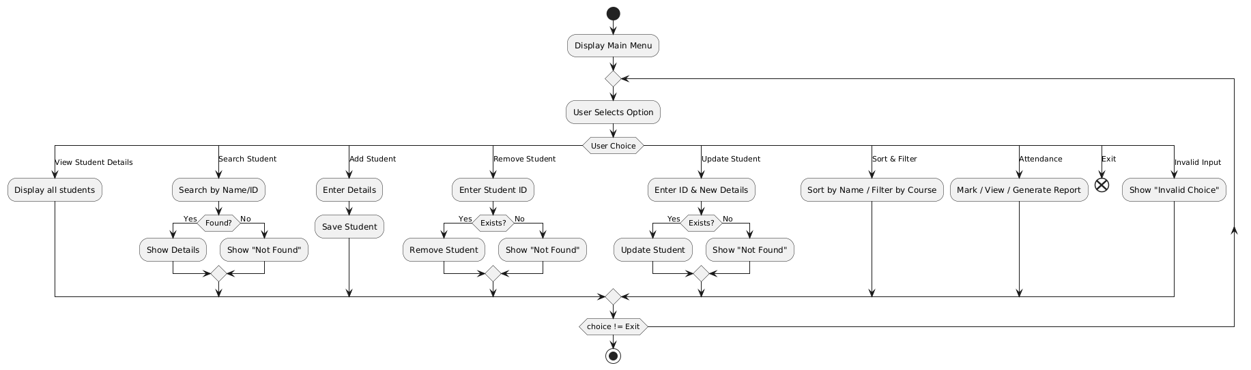
System Design Diagram
Flowchart of the System :

Slide 8
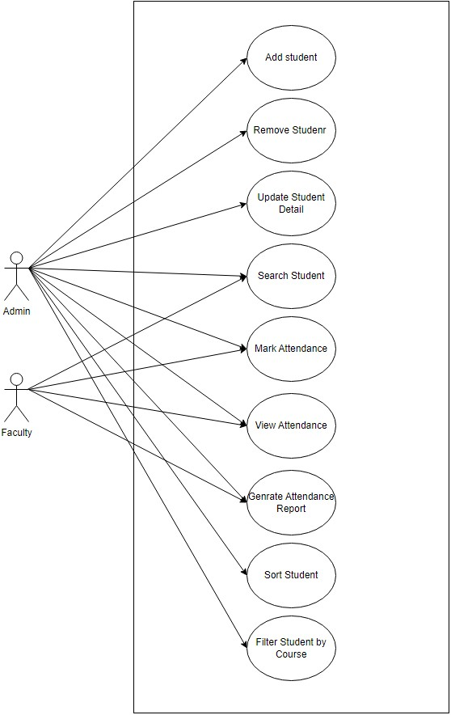
Use Case Diagram
Actors: Admin.
Use Cases: Add Student, Remove Student, Update Student, Search Student, Mark Attendance, Generate Reports.
Diagram Example:
Admin interacts with all use cases.
Example:
Admin → Add Student → Confirmation.
Faculty →Genrate attendance report →Display report

Slide 9
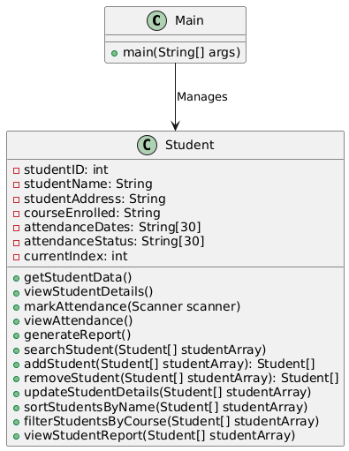
Class Diagram
Classes:
Main: Contains the main method and menu logic.
Student: Contains student details and methods for attendance and reporting.
Attributes and Methods:
Main: main(String[]args), addStudent(), removeStudent() ,updateStudent(), searchStudent(), markAttendance() ,generateReport().
Student: String name, String id, String address, String course, boolean[] attendance, markAttendance(int day), getAttendance(): boolean[].
Relationships: Main uses Student.

Slide 10
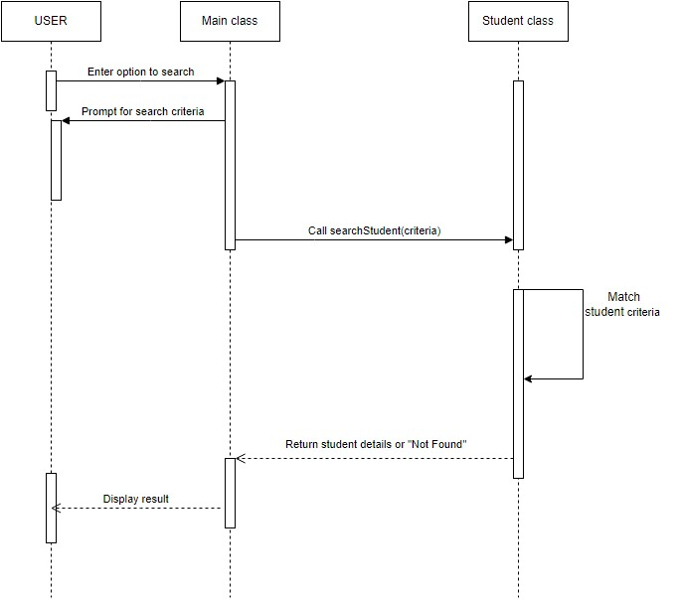
Sequence Diagram
Flow of Operations :
User Initiation:
The user selects the option to search for a student.
The system (Main class) prompts the user for search criteria.
Processing in the Main Class:
The Main class calls the searchStudent(criteria) function in the Student class.
The Student class checks if any student matches the given criteria.
Student Class Processing:
If a match is found, student details are returned.
If no match is found, a "Not Found" response is returned.
Displaying the Result:
The Main class receives the result and displays it to the user.

Slide 11
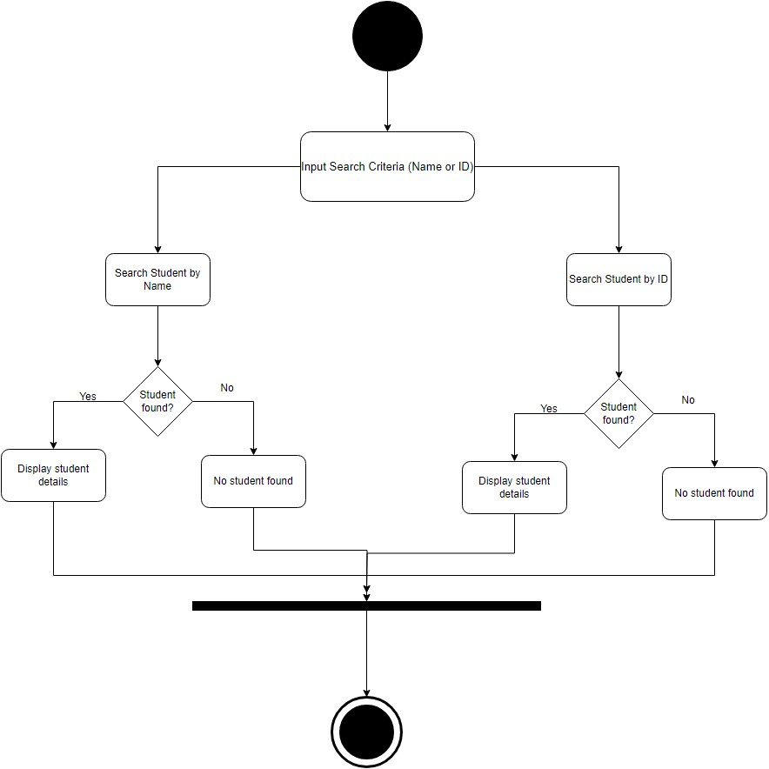
Activity Diagram
This Activity daigram illustrates the Search Student Process based on input criteria:
Input Search Criteria: The user enters search criteria (name or ID).
Search by Name: If searching by name:
If the student is found, their details are displayed.
If not found, a "No student found" message is shown.
Search by ID: If searching by ID:
If the student is found, their details are displayed.
If not found, a "No student found" message is shown.

Slide 12
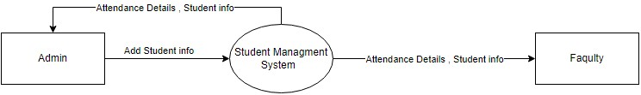
Data Flow Diagram
Level 0 DFD:
This diagram represents a Context-Level Data Flow Diagram (DFD) for a Student Management System (SMS). It illustrates the external entities interacting with the system:
Admin: Provides input and manages student data and system operations.
Faculty: Interacts with the system to update student attendance or retrieve data.

Slide 13
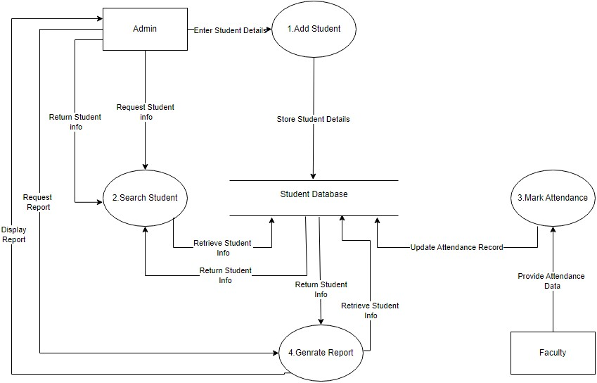
Data Flow Diagram
Level 1 DFD:
This (DFD) for a Student Management System shows the flow of data between the system, actors, and processes:
Add Student: Admin adds student details, which are stored in the student database.
Search Student: Admin requests student information, and the database returns the data.
Mark Attendance: Faculty updates student attendance in the database.
Generate Report: Admin requests a report, which is generated using student data.
View Attendance: Students can retrieve their attendance records from the database.
The student database acts as the central data store, connecting all processes and external entity.

Slide 14
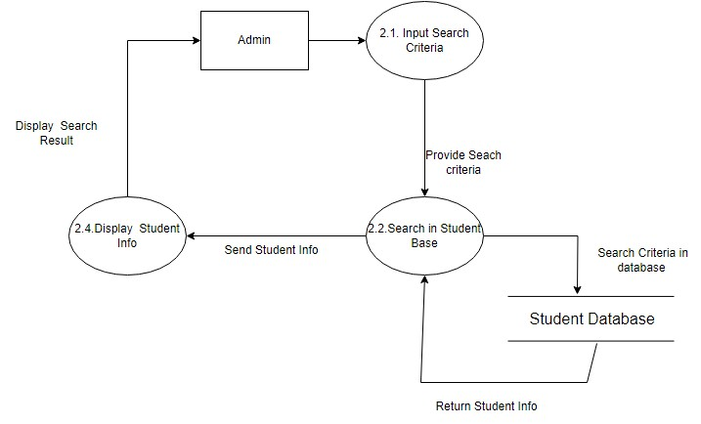
Data Flow Diagram
Level 2 DFD:
This expanded Level 2 Data Flow Diagram (DFD) focuses on the "Search Student" process:
2.1 Input Search Criteria: Admin provides search criteria (e.g., student name or ID).
2.2 Search in Student Base: The system searches the student database using the provided criteria.
Student Database: The database returns matching student information.
2.4 Display Student Info: The system displays the search results to the admin.
This detailed process shows the flow of data from input to the display of search results, with the student database as the central data source.

Slide 15
Limitations
Fixed-size arrays for attendance (max 30 records).
No persistent storage (data is lost after program termination).
Limited error handling for invalid inputs.
Basic UI (command-line interface).

Slide 16
Future Work
Implement a database for persistent storage.
Add a graphical user interface (GUI).
Enhance error handling and input validation.
Extend features (e.g., grading system, fee management).

Slide 17
Thank You !!

